Slide 1






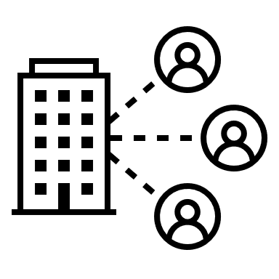


Background
CS301: ITSA
GROUP 8
Jasmine
Wei Hao
Junxiang
James
Wen Jie
Hotels
Project Proposal Hotel Booking System
Customers

Slide 2
CS301: ITSA
GROUP 8
Speed
Scalability
Background
Jasmine
Wei Hao
Junxiang
James
Wen Jie
Hotels
Customers
Maintainability
Data Security
Project Proposal Hotel Booking System

Slide 3

Business
Background
IT
Business Needs
Speed
Scalability
Hotels
Maintainability
Data Security
Customers
Customers
Hotels

Slide 4
Speed
Business Needs
Scalability
Stakeholders
Business
IT
Hotels
Customers
Hotels
Maintainability
Data Security
View Available Rooms
Login To System
Search Destination
By Location
View Hotels By Price
Autocomplete
Search Input
Book Hotel
Check Booking Information

Slide 5
Stakeholders
Features > Use Cases
Performance
Reliability
Maintainability
Security
Hotel
Search
Booking
Data
Destination
Search
Autocomplete <100ms/request
SLA 99.9% Uptime
Deployment Zero Downtime
Mozilla Observatory A Grade
View Available Rooms
Login To System
Search Destination
By Location
Multi-AZ Datacenters
Active/Passive Standby
AWS Application Load Balancing
AWS Auto-Scaling Group (80%/20%)
OWASP Secure Coding Practices
WAF Filter Rule Firewall
Separate Web & DB Servers (DMZ)
Revalidate Data (Server Side)
Hotels
View Hotels By Price
Autocomplete
Search Input
Caching
Load Balancer
Book Hotel
AWS Codedeploy
Check Booking Information
Customers
Hotels

Slide 6
Features > Use Cases
Quality Metrics
Performance
Reliability
Maintainability
Security
Hotel
Search
Booking
Data
Destination
Search
Autocomplete <100ms/request
SLA 99.9% Uptime
Deployment Zero Downtime
Mozilla Observatory A Grade
View Available Rooms
Login To System
Search Destination
By Location
Multi-AZ Datacenters
Active/Passive Standby
AWS Application Load Balancing
AWS Auto-Scaling Group (80%/20%)
OWASP Secure Coding Practices
WAF Filter Rule Firewall
Separate Web & DB Servers (DMZ)
Revalidate Data (Server Side)
View Hotels By Price
Autocomplete
Search Input
Caching
Load Balancer
Book Hotel
AWS Codedeploy
Check Booking Information

Slide 7
Features > Use Cases
Quality Metrics
Performance
Reliability
Maintainability
Security
Hotel
Search
Booking
Data
Destination
Search
Autocomplete <100ms/request
SLA 99.9% Uptime
Deployment Zero Downtime
Mozilla Observatory B Grade
View Available Rooms
Login To System
Search Destination
By Location
Multi-AZ Datacenters
Active/Passive Standby
AWS Application Load Balancing
AWS Auto-Scaling Group (80%/20%)
OWASP Secure Coding Practices
WAF Filter Rule Firewall
Separate Web & DB Servers (DMZ)
Revalidate Data (Server Side)
View Hotels By Price
Autocomplete
Search Input
Caching
Load Balancer
Book Hotel
AWS Codedeploy
Check Booking Information

Slide 8
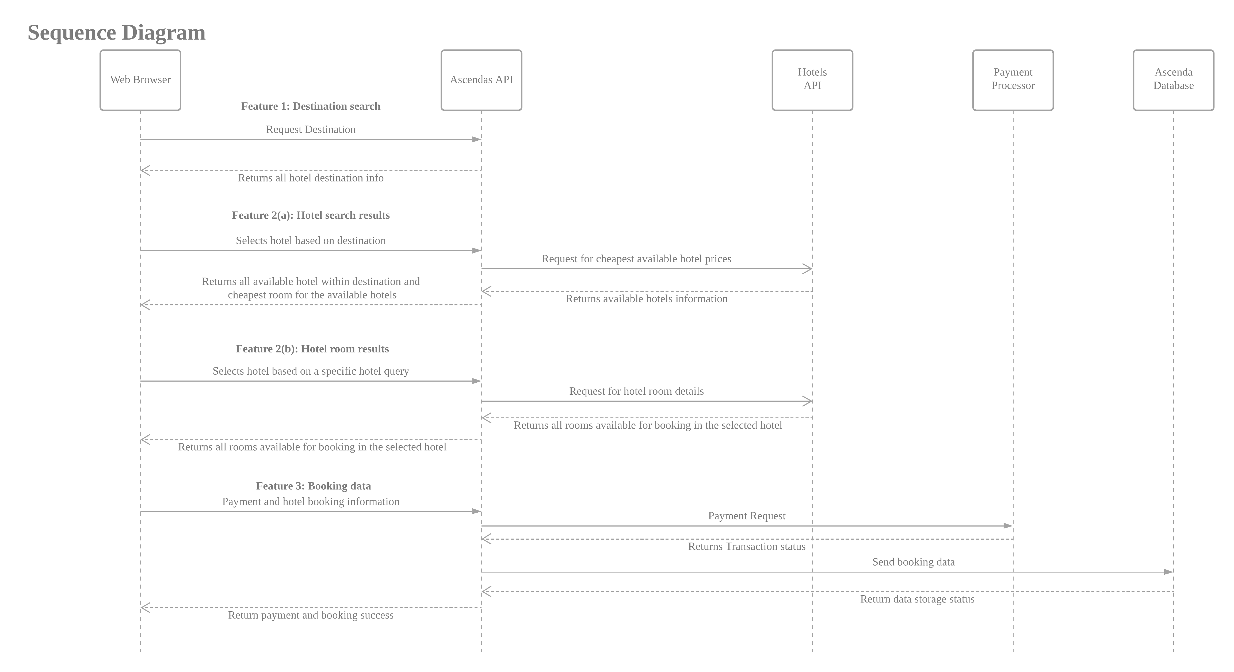
Quality Metrics
Proposed Budget
Services
Cost ($/Month)
AWS Elastic Beanstalk (EBS)
$6.26
AWS Application Load Balancer (ALB)
Free Tier
AWS RDS MySQL
Free Tier
AWS Simple Cloud Storage (S3)
Free Tier
AWS API Gateway
Free Tier
AWS CloudWatch
Free Tier
AWS API Gateway
Free Tier
AWS CodeDeploy
$0.40
AWS CloudFront
Free Tier
AWS Web Application Firewall (WAF)
$5.60
AWS Lambda
Free Tier
Domain Name (Domain.com)
$6.99
Total:
$19.61
Autocomplete <100ms/request
SLA 99.9% Uptime
Deployment Zero Downtime
Mozilla Observatory A Grade
Multi-AZ Datacenters
Active/Passive Standby
AWS Application Load Balancing
AWS Auto-Scaling Group (80%/20%)
OWASP Secure Coding Practices
WAF Filter Rule Firewall
Separate Web & DB Servers (DMZ)
Revalidate Data (Server Side)
Caching
Load Balancer
AWS Codedeploy

Slide 9
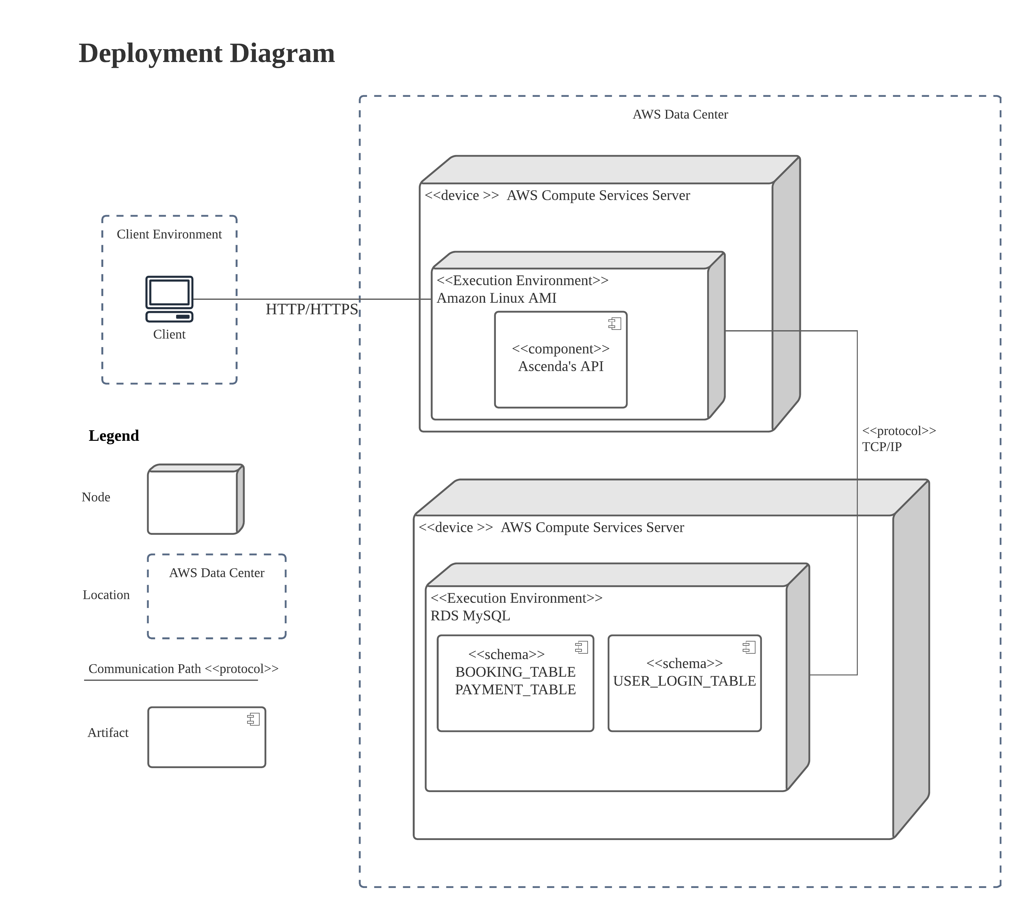
Proposed Budget
Views
(Sequence)
AWS Elastic Beanstalk (EBS)
$6.26
AWS Application Load Balancer (ALB)
Free Tier
AWS RDS MySQL
Free Tier
AWS Simple Cloud Storage (S3)
Free Tier
AWS API Gateway
Free Tier
AWS CloudWatch
Free Tier
AWS API Gateway
Free Tier
AWS CodeDeploy
$0.40
AWS CloudFront
Free Tier
AWS Web Application Firewall (WAF)
$5.60
AWS Lambda
Free Tier
Domain Name (Domain.com)
$6.99
Total:
$19.61

Slide 10

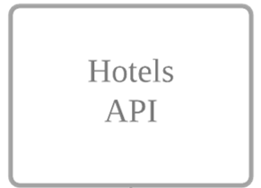
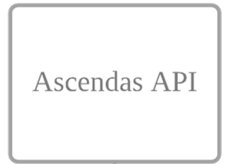
Proposed Budget
Views
(Sequence)

Slide 11
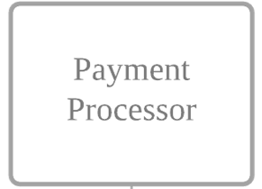
Proposed Budget
Views
(Sequence)

Slide 12
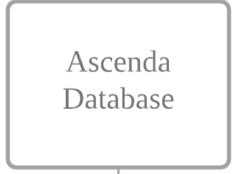
Proposed Budget
Views
(Sequence)

Slide 13
Proposed Budget
Views
(Sequence)

Slide 14
Proposed Budget
Views
(Sequence)

Slide 15
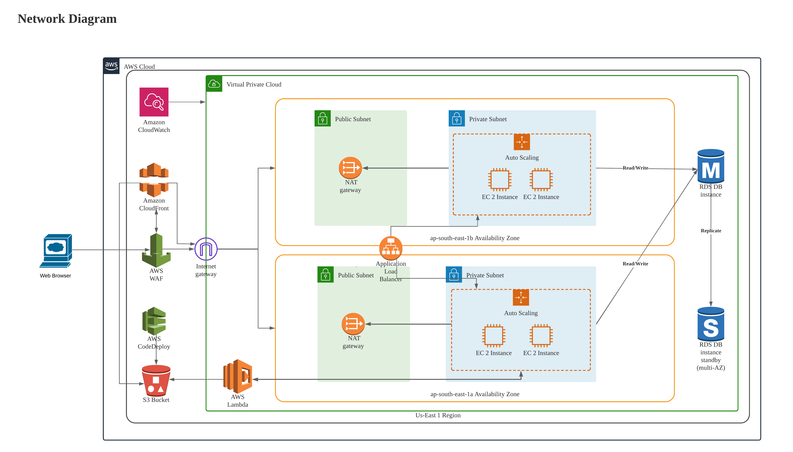
Proposed Budget
Views
(Sequence)

Slide 16
Proposed Budget
(Sequence)
Views
(Architecture)

Slide 17
Proposed Budget
(Sequence)
Views
(Architecture)

Slide 18
Proposed Budget
(Sequence)
Views
(Architecture)

Slide 19
Proposed Budget
(Sequence)
Views
(Architecture)

Slide 20
Proposed Budget
(Sequence)
Views
(Architecture)

Slide 21
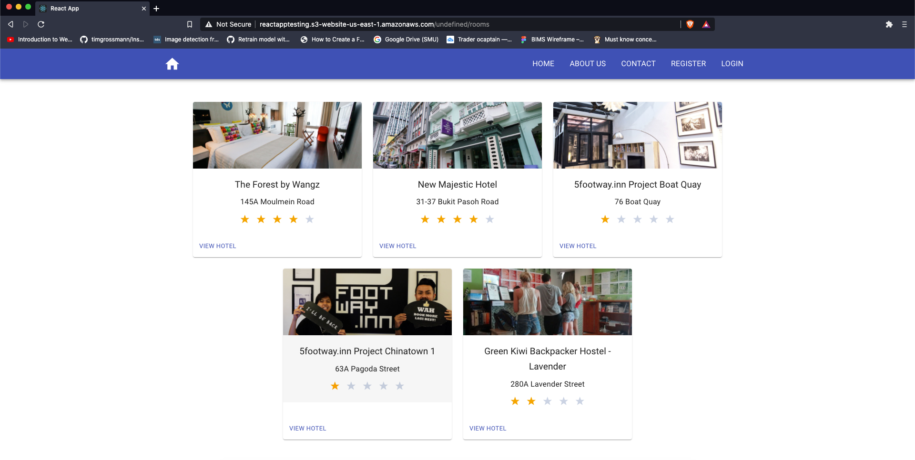
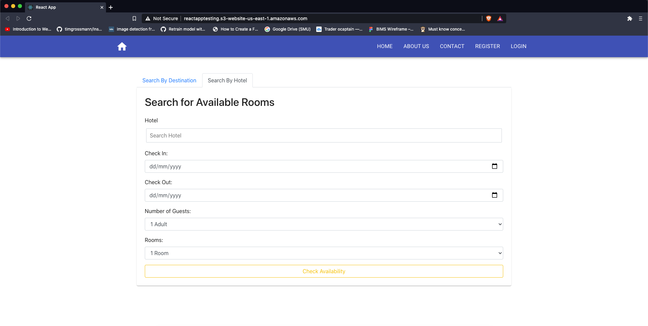
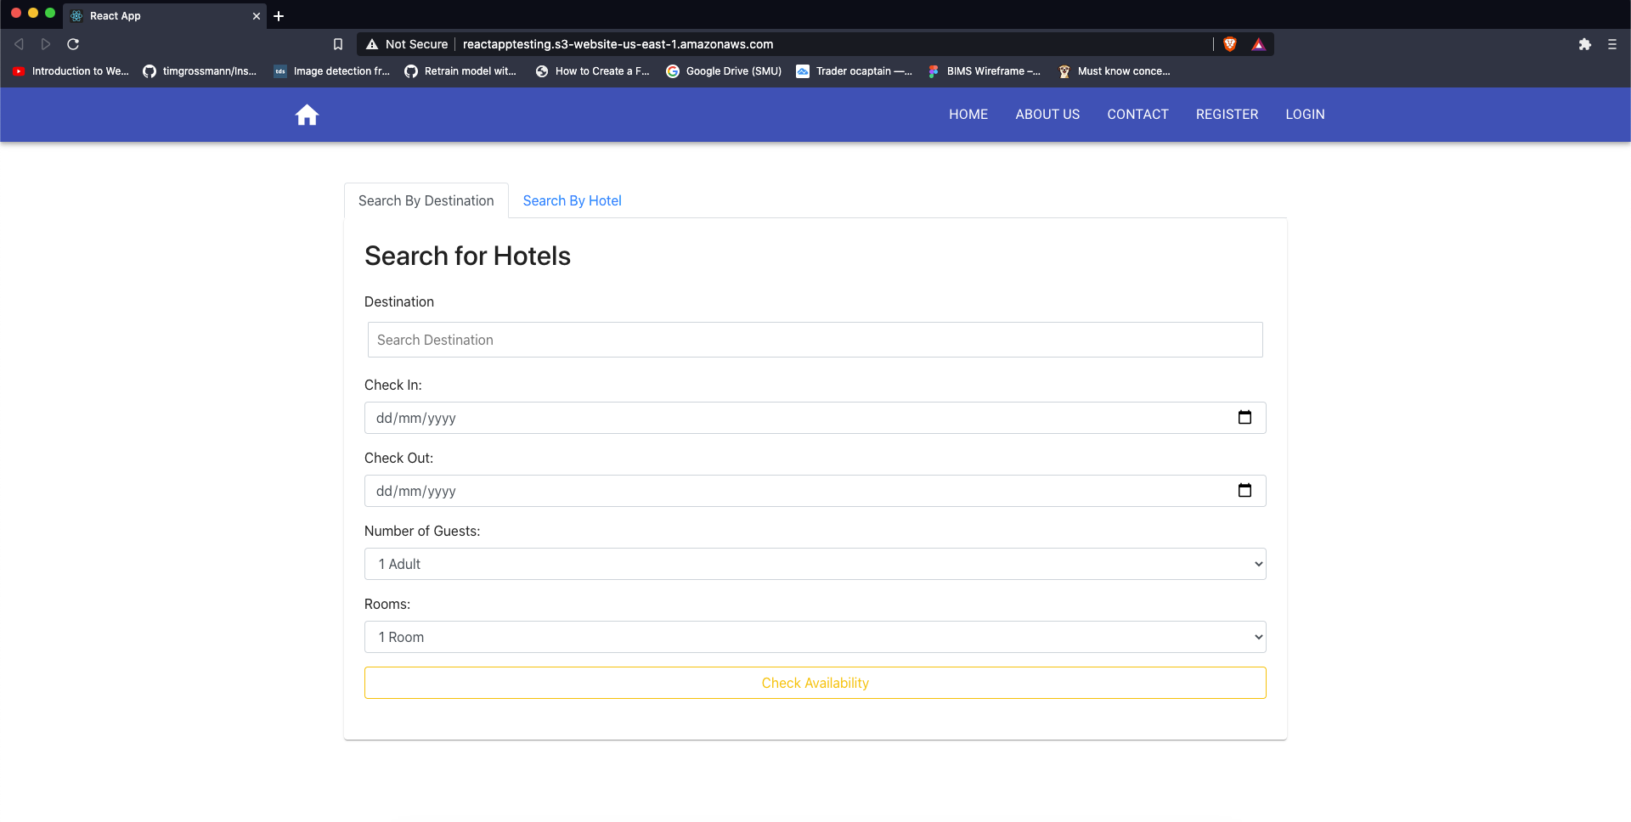
Proposed Budget
(Architecture)
Views
(Deployment)

Slide 22
Proposed Budget
(Architecture)
Views
(Deployment)

Slide 23
Proposed Budget
(Architecture)
Views
(Deployment)

Slide 24
Proposed Budget
(Architecture)
Views
(Deployment)

Slide 25
Proposed Budget
(Deployment)
Views
(Mockups)

Slide 26
Proposed Budget
(Deployment)
Views
(Mockups)

Slide 27
Proposed Budget
(Deployment)
Views
(Mockups)

Slide 28
Views
Mockups
Thank You

